Slide 1
Chapter 01
Introduction
Object Oriented Programming (SE 6022)

Slide 2
Objectives
After studying this chapter, students should be able to:
Learn about Programming Paradigms
Understand OOP Concepts and Features
Fundamental Java Programming Structures:
  Tokens: Identifiers, Separators, Operators, keywords & Literals
  Constants, variables and primitive data types
  The main() method
  Control statements: if, switch, while, do…while, for and Jumps in loops
  Array & Strings in java

Slide 3
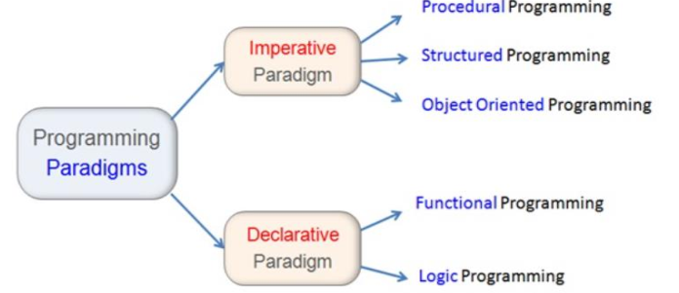
Programming Paradigms
Programming Paradigm is a way of conceptualizing what it means to perform computation and how tasks to be carried out and organized on a computer.
Imperative Paradigms: Command driven, directs the written code execution as sequence of statements executed one by one. Consist of set of program statements

Slide 4
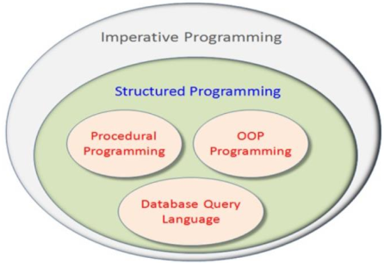
Programming Paradigms
The execution of the program statements is decided by the control flow statements. And the program flow can be directed as per the program logic.
Control flow in imperative programming is explicit: commands show how the computation takes place, step by step. Each step affects the global state of the computation.
Structured Programming
Problem solving would involve the analysis of processes in terms of the procedural tasks carried out and the production of a system whose representation is based on the procedural flow of the processes.
data was separate from code.
programmer is responsible for organizing everything in to logical units of code/data
Use the program control flow constructs, decision making (IF, IF THEN, ELSE) constructs and the iteration constructs (for, while loops), blocks and functions

Slide 5
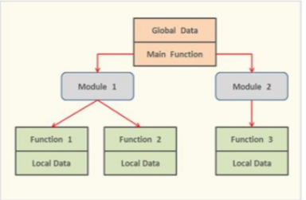
Programming paradigms
structured programming is to improve the readability of the code. This facilitates the re-usability of the code by dividing the code into semi-independent modules.
A procedural programming is divided into functions, and (ideally, at least) each function has a clearly defined purpose & a clearly defined interface to the other functions in the program.

Slide 6
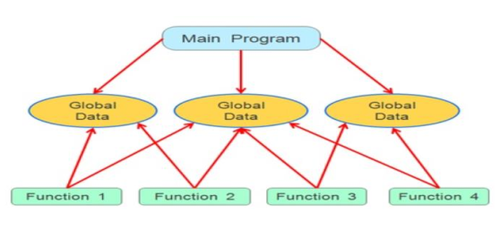
Programming paradigms
The function consists of group of computational steps that directs the computer to perform specific operation.
The function once defined can be called many times in the program to repeat the same operation.
  Real-World Modeling
    Unrelated functions and data, the basics
    of the procedural paradigm, provide a poor model of the real world.
  Difficult of Creating New Data Types
    Traditional languages are not extensible because they will not let you create new data types.
  Disadvantages
  Unrestricted Access
    Functions have unrestricted access
    to global data.

Slide 7
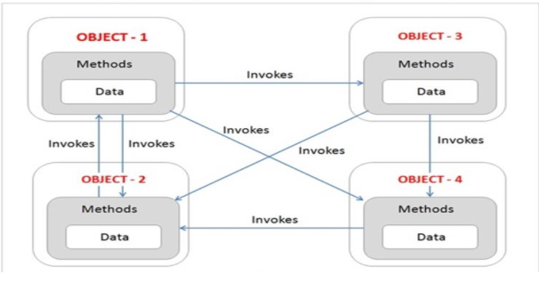
Programming paradigms
Object Oriented Programming: OOP is type of structured programming that views the program components as object.
An object binds the data and the associated methods together as single unit.
The programmer can control the data access permissions by defining the access specifier.
They robust, security features.

Slide 8
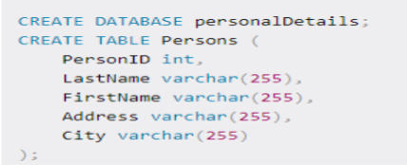
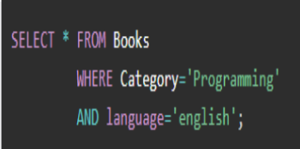
Programming paradigms
Database Query Language: Database is vital component of most software projects. Relational Database Management System (RDBMS) support the SQL for database programming. Structured Query Language (SQL) is the most commonly used example of model based language.
Declarative Paradigm: focus on the logic of program and the end result.
The control flow is not the important element of the program. The main focus is achieving the end result. It is called straight forward paradigm. The declarative paradigm focuses on what is to be solved.

Slide 9
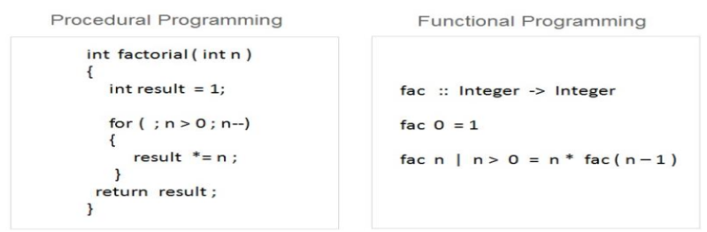
Programming paradigms
Functional Programming: is mathematical functions. It attempts to solve the problem by composing mathematical functions as a program components.
The computer program is created with the application and composing the mathematical functions. It is also known as Parallel processing approach.
In functional programming, program written in programming language will always produce output exactly similar to its equivalent mathematical function

Slide 10
Programming paradigms
Logic Programming: The term logic means essentially facts and rules. Whereas control means, an order of rules. The term algorithm is defined as logic plus control (Logic + Control). The logic defines what should be solved and the control defines how it should be solved.
The program written in logic programming language consists of set of program statements in the logical form. Each statement is an expression of facts, rules and order of rules. The logic programming is an abstract model of computation. It is based on the first order predicate logic (FOL).
A logical program is divided into three sections:
1. a series of definitions/declarations that define the problem domain
2. statements of relevant facts
3. statement of goals in the form of a query( Rule )

Slide 11
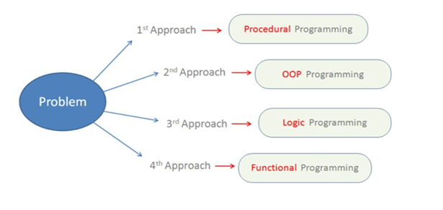
Contd…

Slide 12
Contd…
OOP Approach
A modern programming paradigm that allows the Programmer to model a problem in a real-world fashion as an object.
Major objective is to eliminate some of the flaws encountered in the procedural approach.
OOP allows us to decompose a problem into number of entities called objects and then build data and methods (functions) around these entities.
The data of an object can be accessed only by the methods associated with the object
Follows bottom-up approach in program design

Slide 13
Contd…
Features of OOP
Emphasis is on data rather than procedure.
Programs are divided into objects.
Data Structures are designed such that they characterize the objects.
Methods that operate on the data of an object are tied together in the data structure.
Data is hidden and can not be accessed by external functions.
Objects may communicate with each other through methods.

Slide 14
Basic OOP Concepts
The following are the basic OOP concepts:
Objects
Classes
Data Abstraction
Data Encapsulation
Inheritance
Polymorphism
Dynamic Binding
Message Passing

Slide 15
Contd…
Object
  An object is an any real world entity which may represent place, person, data item related to program.
  An object has state, behavior and identity.
  Ex. A ‘Mouse’ object has,
  State: moving or working
  Behavior: picking or pointing an object on the screen
  Identity: color, company, Identification No. etc.
  An object is a variable/instance of class.
  An object is a run-time entity.
Class
  Is the template or blueprint that defines the states and the behaviors common to all objects of a certain kind.
  It is a collection of objects of similar type.
  Classes are user-defined data types & behave like the built-in types of programming language.

Slide 16
Contd…
Data Abstraction
Abstraction means representing essential features without including the background details or explanations
A classes can use the concept of Abstraction and are defined as list of abstract data and functions to operate on these data.
Since the classes use the concept of Data Abstraction, they are known as Abstract Data Type(ADT).
Data Encapsulation
The wrapping up of data and methods into a single unit (called class) is known as encapsulation.
This insulation of the data from direct access by the program is called data hiding.

Slide 17
Contd…
Inheritance
Is the process by which objects of one class acquire the properties of objects of another class.
It provides the idea of reusability( reusing the code)
Polymorphism
In polymorphism, ‘Poly’ means many and ‘morph’ means forms, i.e. many forms.
Is the ability to take more than one form. It allows a function responding in different ways.
Dynamic Binding
Dynamic binding means that the code associated with a given procedure call is not known until the time of the call at runtime.
Memory is allocated at runtime not at compile time.

Slide 18
Contd…
Message Passing
The process of invoking an operation of an object is called Massage Passing.
In response to the given massage, the respective method or operation is called.
OOPs includes objects which communicates by sending/ receiving information with each other.
Message Passing involves specifying the name of the object, the name of the function (message) and the information to be sent.
employee.salary (name);
A message for an object is a request for the execution of a procedure.

Slide 19
Introduction to Java
Java is an Object Oriented Programming language developed by Sun Microsystems in the year 1991.
Initially it was named as “Oak” by James Gosling
In 1995, “Oak” is renamed to “Java” because the name “Oak” did not survive legal registration.
James Gosling and his team members were consuming a lot of coffee while developing this language.
Good quality of coffee was supplied from a place called “Java Island’. Hence they fixed the name of the language as Java. The symbol for Java language is cup and saucer.
Sun formally announced Java at Sun World conference in 1995. On January 23rd 1996, JDK1.0 version was released.

Slide 20
Features of Java (Java Buzzwords)
Simple: Learning and practicing Java is easy because of resemblance with C and C++.
Object Oriented: Unlike C++, Java is purely OOP.
Distributed: Java is designed for use on network; it has an extensive library which works in agreement with TCP/IP.
Secure: Java is designed for use on Internet. Java enables the construction of virus-free, tamper free systems.
Robust (Strong/ Powerful): Java programs will not crash because of its exception handling and its memory management features.
Portable: Java does not have implementation dependent aspects and it gives same result on any machine.

Slide 21
Contd…
Interpreted: Java programs are compiled to generate the byte code(.class file). This byte code can be interpreted by the interpreter contained in JVM.
Architectural Neutral Language: Java byte code is not machine dependent, it can run on any machine with any processor and with any OS.
High Performance: Along with interpreter there will be JIT (Just In Time) compiler which enhances the speed of execution.
Multithreaded: Executing different parts of a program simultaneously is called multithreading. This is an essential feature to design server side programs.
Dynamic: We can develop programs in Java which dynamically change on Internet (e.g.: Applets).

Slide 22
Java Environment
Java Environment includes a large number of development tools and hundreds of classes and methods.
The development tools are part of the system known as Java Development Kit (JDK) and the classes and methods are part of the Java Standard Library (JSL), also known as Application Programming Interface (API).
JDK comes with a collection of tools that are used for developing and running java programs:
  appleviewer (for viewing java applets )
  javac (java compiler)
  java (java interpreter)
  javap (java disassembler)
  javah (for C header files)
  javadoc (for creating HTML documents)
  jdb (Java debugger)

Slide 23
Java API
It includes hundreds of classes and methods grouped into several functional packages.
Most commonly used packages are:
    Language Support Package: a collection of classes and methods required for implementing basic features of java.
    Utilities Package: a collection of classes to provide utility functions such as date and time functions.
    Input/output Package: a collection of classes required for input/output manipulation.
    Networking Package: a collection of classes for communicating with other computers via Internet.
    AWT Package (Abstract Window Tool kit package): contains classes that implements platform-independent graphical user interface.
    Applet Package: includes set of classes that allows us to create java applets.

Slide 24
Programming Structure
In Java programming language:
  A program is made up of one or more classes
  A class contains one or more methods
  A method contains program statements
In Java, first we need to import the required packages. By default, java.lang.* is imported. Java has several such packages in its library.
A package is a kind of directory that contains a group of related classes and interfaces. A class or interface contains methods.
Since Java is purely an Object Oriented Programming language, we cannot write a Java program without having at least one class or object. So, it is mandatory to write a class in Java program. We should use class keyword for this purpose and then write class name.

Slide 25
Contd…
// comments about the class
class header
public class Class-name
{
}
// comments about the method
public static void main (String[] args)
class body
{
}
method header
method body
Comments can be placed almost anywhere

Slide 26
First Java Program
// MyProgram.java
public class Sample
{
public static void main( String args[])
{
System.out.println(“ Hello World! “);
}
}
  Let us discuss the program line by line:
  Class Declaration: the first line class Sample declares a class, which is an object constructor. Class is keyword and declares a new class definition and Sample is a java identifier that specifies the name of the class to be defined.

Slide 27
Contd…
  Braces : Every class definition in java begins with an opening brace “{“ and ends with a closing brace “}”.
  The main line: the third line public static void main(String args[]) defines a method named as main, is the starting point for the interpreter to begin the execution of the program.
    public: is an access specifier that declares the main method as “unprotected” and therefore making it accessible to all other classes.
    static: declares that this method as one that belongs to the entire class and not a part of any objects of the class.
      Main must always be declared as static since the interpreter uses this method before any objects are created.
    void : states that the main method does not return any value (but prints some text to the screen.)

Slide 28
Contd…
  All parameters to a method are declared inside a pair of parenthesis. Here, String args[ ] declares a parameter named args, which contains array of objects of the class type String.
  The Output Line: The only executable statement in the program is System.out.println(“Hello World!” );
    This is similar to cout<< constructor of C++.
    The println method is a member of the out object, which is a static data member of System class.

Slide 29
Java Program Structure

Slide 30
Documentation Section
Comprises a set of comment lines giving the name of the program, the author and other details, which the programmer would like to refer at a later stage.
Comments are description about the aim and features of the program.
Comments increase readability of a program.
Java supports three types of comments:
  Single line comment //
  Multiple line comment /*………………
  ………………*/
  Documentation comment /**….*/
    This form of comment is used for generating documentation automatically.

Slide 31
Package Statement
Is the first statement in Java file and is optional.
It declares a package name and informs the compiler that the classes defined here belong to this package.
  Example: package student;
Import statements
Next to package statements (but before any class definitions) a number of import statements may exist. This is similar to #include statements in C or C++.
Using import statements we can have access to classes that are part of other named packages.
  Example: import java.lang.Math;

Slide 32
Interface Statements
An interface is like a class but includes a group of method declarations.
is also an optional section.
is used only when we wish to implement the multiple inheritance features in the program
Class Definitions
A Java program may contain multiple class definitions.
Classes are the primary and essential elements of a Java program.
These classes are used to map objects of real-world problems.
The number of classes depends on the complexity of the problem.

Slide 33
Main Method
Since every Java stand-alone program requires a main method as its starting point, this class is the essential part of a Java program.
A simple Java program may contain only this part.
The main method creates objects of various classes and establishes communications between them.
On reaching the end of main, the program terminates and control passes back to the operating system.

Slide 34
Creating a Source File
Type the program in a text editor (i.e. Notepad, WordPad, Microsoft Word or Edit Plus).
  We can launch the Notepad editor from the Start menu by selecting Programs > Accessories > Notepad. In a new document, type the above code (i.e. Sample Program).
Save the program with filename same as Class_name (i.e. Sample.java) in which main method is written. To do this in Notepad, first choose the File > Save menu item. Then, in the Save dialog box:
Using the Save in combo box, specify the folder (directory) where you'll save your file.
In this example, the directory is JQR on the D drive.
In the File name text field, type "Sample.java", including the quotation marks. Then the dialog box should look like this:

Slide 35
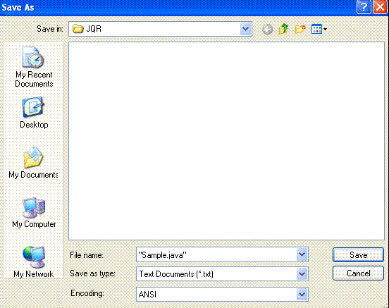
Contd…
Now click Save, and exit Notepad.

Slide 36

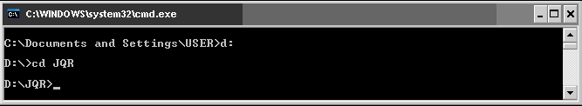
Executing the Source File
To Compile the Sample.java program go to DOS prompt. We can do this from the Start menu by choosing Run... and then entering cmd. The window should look similar to the following figure.
The prompt shows current directory. To compile Sample.java source file, change current directory to the directory where Sample.java file is located. For example, if source directory is JQR on the D drive, type the following commands at the prompt and press Enter:
Now the prompt should change to D:\JQR>

Slide 37
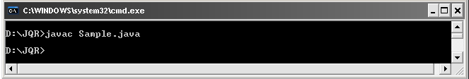

Contd…
At the prompt, type the following command and press Enter: javac Sample.java
The compiler generates byte code and Sample.class will be created.
To run the program, enter java followed by the class name created at the time of compilation at the command prompt in the same directory as: java Sample
The program interpreted and the output is displayed.

Slide 38
Java Tokens
A class in java is defined by a set of declaration statements and methods containing executable statements.
Most statements contain expressions, which describe the actions carried out on data.
Smallest individual units in a program are known as tokens.
In simplest terms, a java program is a collection of tokens, comments, and white spaces.
Java has five types of tokens: Reserved Keywords, Identifiers, Literals, Separators and Operators .

Slide 39
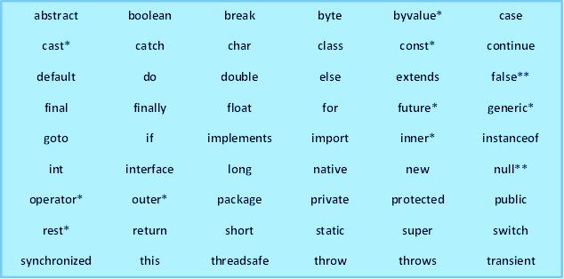
Keywords
Are essential part of a language definition and can not be used as names for variables, classes, methods and so on.
Java language has reserved 60 words as keywords.

Slide 40
Identifiers
Are programmer-designed tokens.
Are used for naming classes, methods, variables, objects, labels, packages and interfaces in a program.
Java identifiers follow the following rules:
  They can have alphabets, digits, and the underscore and dollar sign characters.
  They must not begin with a digit
  Uppercase and lowercase letters are distinct.
  They can be of any length.

Slide 41

POP QUIZ
Which of the following are valid Identifiers?
$amount
6tally
my*Name
salary
score
first Name
total#
cast

Slide 42
Literals
Literals in Java are a sequence of characters(digits, letters and other characters) that represent constant values to be stored in variables.
Five major types of literals in Java:
  Integer Literals: refers to a sequence of digits (decimal integer, octal integer and hexadecimal integer)
  Floating-point Literals
  Character Literals
  String Literals
  Boolean Literals

Slide 43
Separators
Are symbols used to indicate where groups of code are divided and arranged.
They basically define the shape and functions of our code.
Java separators include:
  Parenthesis ( ) :- used to enclose parameters, to define precedence in expressions, surrounding cast types
  Braces { } :- used to contain the values of automatically initialized arrays and to define a block of code for classes, methods and local scopes.

Slide 44
Contd…
Brackets [ ] :- are used to declare array types and for dereferencing array values.
Semicolon ; :- used to separate statements.
Comma , :- used to separate consecutive identifiers in a variable declaration, also used to chain statements together inside a “for” statement.
Period . :- Used to separate package names from sub-package names and classes; also used to separate a variable or method from a reference variable.

Slide 45
Operators
Are symbols that take one or more arguments (operands) and operates on them to a produce a result.
Are used to in programs to manipulate data and variables.
They usually form a part of mathematical or logical expressions.
Expressions can be combinations of variables, primitives and operators that result in a value.

Slide 46
Java Operators
There are 8 different groups of operators in Java:
  Arithmetic operators
  Relational operators
  Logical operators
  Assignment operator
  Increment/Decrement operators
  Conditional operators
  Bitwise operators
  Special operators

Slide 47

Arithmetic Operators
Java has five basic arithmetic operators
They all work the same way as they do in other languages.
We cannot use these operators on boolean type .
Unlike C and C++, modulus operator can be applied to the floating point data.
Order of operations (or precedence) when evaluating an expression is the same as you learned in school (BODMAS).
Operator | Meaning
+ | Addition or unary plus
– | Subtraction or unary minus
* | Multiplication
/ | Division
% | Modulo division

Slide 48
Relational Operators
Relational operators compare two values
Produces a boolean value (true or false) depending on the relationship.
Java supports six relational operators:
Relational expressions are used in decision statements such as, if and while to decide the course of action of a running program.
Operator | Meaning
< | Is less than
<= | Is less than or equal to
> | Is greater than
>= | Is greater than or equal to
== | Is equal to
!= | Is not equal to

Slide 49
Examples of Relational Operations
int x = 3;
int y = 5;
boolean result;
  1) result = (x > y);
  now result is assigned the value false because 3 is not greater than 5
  2) result = (15 == x*y);
  now result is assigned the value true because the product of 3 and 5 equals 15
  3) result = (x != x*y);
  now result is assigned the value true because the product of x and y (15) is not equal to x (3)

Slide 50
Logical Operators
Symbol | Name
&& | Logical AND
|| | Logical OR
! | Logical NOT
Logical operators can be referred to as boolean operators, because they are only used to combine expressions that have a value of true or false.
The logical operators && and || are used when we want to form compound conditions by combining two or more relations.
An expression which combines two or more relational expressions is termed as a logical expression or a compound relational expression.

Slide 51
Examples of Logical Operators
boolean x = true;
boolean y = false;
boolean result;
  Let result = (x && y);
  now result is assigned the value false
  (see truth table!)
  Let result = ((x || y) && x);
  (x || y) evaluates to true
  (true && x) evaluates to true
  now result is assigned the value true

Slide 52
Assignment Operator
Are used to assign the value of an expression to a variable.
In addition to the usual assignment operator(=), java has a set of ‘shorthand’ assignment operators which are used in the form:
  var op = expr ;
  Where var is a variable, op is a binary operator and expr is an expression. The operator op = is known as shorthand assignment operator.
The assignment statement: var op= expr; is equivalent to var=var op(expr);
Examples:
    x += y + 5; is equivalent to x = x+(y+5);
    y *= 7; is equivalent to y = y * 7;

Slide 53
Increment/Decrement Operators
count = count + 1;
can be written as:
++count; or count++;
++ is called the increment operator.
count = count - 1;
can be written as:
--count; or count--;
-- is called the decrement operator.
Both ++ and -- are unary operators.

Slide 54
Increment/Decrement operator has two forms:
The prefix form ++count, --count
first adds/subtracts1 to/from the variable and then continues to any other operator in the expression
int numOranges = 5;
int numApples = 10;
int numFruit;
numFruit = ++numOranges + numApples;
numFruit has value 16
numOranges has value 6
The postfix form count++, count--
first evaluates the expression and then adds 1 to the variable
int numOranges = 5;
int numApples = 10;
int numFruit;
numFruit = numOranges++ + numApples;
numFruit has value 15
numOranges has value 6

Slide 55
Conditional Operators
The character pair ?: is a ternary operator available in java.
It is used to construct conditional expression of the form:
  exp1 ? exp2: exp3;
  where exp1, exp2 and exp3 are expressions.
The operator ?: works as follows:
  exp1 is evaluated first. If it is nonzero (true), then the expression exp2 is evaluated and becomes the value of the conditional expression. exp3 is evaluated and becomes the value of the conditional expression if exp1 is false.
Example:
    Given a=10, b=15 the expression
    x=(a>b)? a:b; will assign the value of b to x. i.e. x=b=15;

Slide 56
Bitwise Operators
One of the unique features of java compared to other high-level languages is that it allows direct manipulation of individual bits within a word.
Bitwise operators are used to manipulate data at values of bit level.
They are used for testing the bits, or shifting them to the right or left.
They may not be applied to float or double data types.
Operator | Meaning
& | Bitwise AND
| | Bitwise OR
^ | Bitwise exclusive OR
~ | One’s complement
<< | Shift left
>> | Shift right
>>> | Shift right with zero fill

Slide 57
Special Operators
Java supports some special operators of interest such as instanceof operator and member selection operator(.).
  7.1 instanceof Operator: is an object reference operator and returns true if the object on the left-hand side is an instance of the class given on the right-hand side.
  Example : person instanceof student;
  is true if the object person belongs to the class student; otherwise it is false
7.2 Dot Operator: is used to access the instance variables and methods of class objects.
Example:
person.age; // Reference to the variable age.
person1.salary(); // Reference to the method salary.

Slide 58
Type Conversion in Expressions
  Automatic Type Conversion: If the operands of an expression are of different types, the ‘lower’ type is automatically converted to the ‘higher’ type before the operation proceeds. That is, the result is of the ‘higher’ type.
    Example :
  int a=110;
  float b=23.5;
  the expression a+b yields a floating point number 133.5 since the ‘higher’ type here is float.

Slide 59
Contd…
  Casting a value: is used to force type conversion.
    The general form of a cast is:
      (type-name)expression;
      where type-name is one of the standard data types.
      Example :
  x=(int)7.5; will assign 7 to x
  a=(int)21.3/(int)3.5; a will be 7

Slide 60
Operator Precedence and Associativity.
Operator | Description | Associativity | Rank
. | Member Selection | Left to right | 1
( ) | Function call
[ ] | Array elements reference
- | Unary Minus | Right to left | 2
++ | Increment
-- | Decrement
! | Logical negation
~ | One’s complement
(type) | Casting
* | Multiplication | Left to right | 3
/ | Division
% | Modulus

Slide 61
Contd…
Operator | Description | Associativity | Rank
+ | Addition | Left to right | 4
- | Subtraction
<< | Left Shift | Left to right | 5
>> | Right Shift
>>> | Right shift with zero fill
< | Less than | Left to right | 6
<= | Less than or equal to
> | Greater than
>= | Greater than or equal to
instanceof | Type comparison
== | Equality | Left to right | 7
!= | Inequality

Slide 62
Operator Precedence and Associativity
Operator | Description | Associativity | Rank
& | Bitwise AND | Left to right | 8
^ | Bitwise XOR | Left to right | 9
| | Bitwise OR | Left to right | 10
&& | Logical AND | Left to right | 11
|| | Logical OR | Left to right | 12
?: | Conditional Operator | Left to right | 13
= | Assignment operator | Left to right | 14
Op= | Shorthand assignment | Left to right | 15

Slide 63
POP QUIZ
1) What is the value of number?
int number = 5 * 3 – 3 / 6 – 9 * 3;
2) What is the value of result?
int x = 8;
int y = 2;
boolean result = (15 == x * y);
3) What is the value of result?
boolean x = 7;
boolean result = (x < 8) && (x > 4);
4) What is the value of numCars?
int numBlueCars = 5;
int numGreenCars = 10;
int numCars = numGreenCars++ + numBlueCars + ++numGreeenCars;
-12
false
true
27

Slide 64
Variables
A variable is an identifier that denotes a storage location used to store a data value.
Unlike constants, that remain unchanged during the execution of a program, a variable may take different values at different times during the execution of the program.
It is good practice to select variable names that give a good indication of the sort of data they hold:
  For example, if you want to record the size of a hat, hatSize is a good choice for a name whereas qqq would be a bad choice.

Slide 65
Contd…
Variable names may consist of alphabets, digits, the underscore (_) and dollar ($) characters, subject to the following conditions:
  They should not begin with a digit.
  Keywords should not be used as a variable name.
  White spaces are not allowed.
  Uppercase and lowercase are distinct. i.e. A rose is not a Rose is not a ROSE.
  Variable names can be of any length.

Slide 66
Data Types
Every variable in Java has a data type.
Data types specify the size and type of values that can be stored.
Java is language is rich in the data types.
Java data types are of two type:
  Primitive Data Types (also called intrinsic or built-in data types)
  Non-Primitive data Types (also known as Derived or reference types)

Slide 67
Data Types in Java
Primitive
(Intrinsic)
Non-Primitive
(Derived)
Numeric
Non-Numeric
Classes
Arrays
Interfaces
Integer
Floating-Point
Character
Boolean
Data Types in Java

Slide 68
Primitive Data Types
  There are eight built-in data types in Java:
  4 integer types (byte, short, int, long)
  2 floating point types (float, double)
  Boolean (boolean)
  Character (char)
  All variables must be declared with a data type before they are used.
  Each variable's declared type does not change over the course of the program.

Slide 69
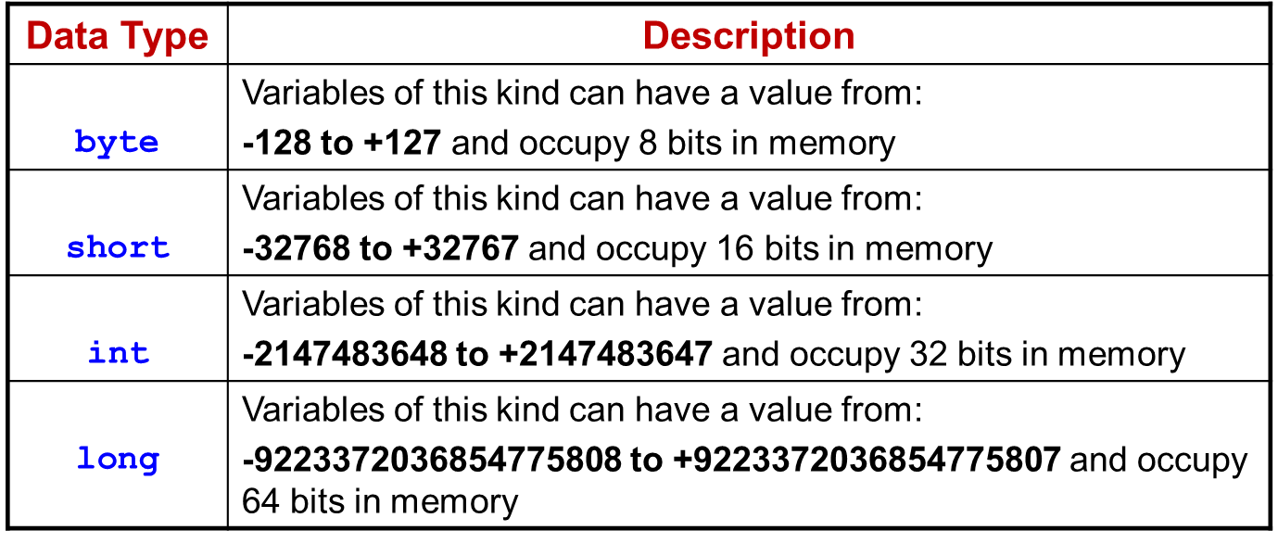
Integer Data types
There are four data types that can be used to store integers.
The one you choose to use depends on the size of the number that we want to store.

Slide 70
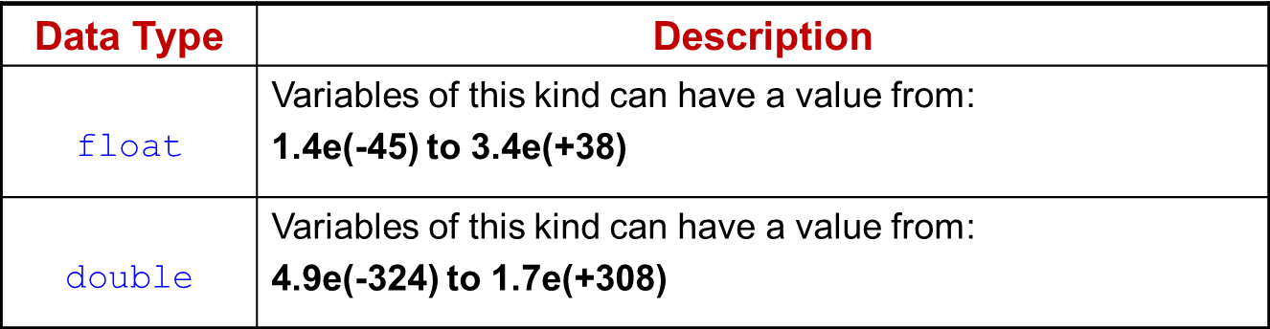
Floating-Point Types
Integer types can hold only whole numbers and therefore we need another type known as floating point type to hold numbers containing fractional parts.
There are two data types that can be used to store decimal values (real numbers).

Slide 71
Character Type
Is used to store character constants in memory.
Java provides a character data type called char
The char data type assumes a size of 2 bytes but, basically, it can hold only a single character.
Note that you need to use singular quotation marks while initializing a variable whose data type is char.
Example:
  char firstLetterOfName = 'e' ;
  char myQuestion = '?' ;

Slide 72
Boolean Type
Boolean is a data type used when we want to test a particular condition during the execution of the program.
There are only two values that a Boolean can take: true or false.
Boolean type is denoted by the keyword boolean and uses only one bit of storage.
All comparison operators return boolean type values.
Boolean values are often used in selection and iteration statements.

Slide 73
Declaration of Variables
After designing suitable variable names, we must declare them to the compiler. Declaration does three things:
  It tells the compiler what the variable name is
  It specifies what type of data the variable will hold
  The place of declaration (in the program) declares the scope of the variable.
A variable must be declared before it is used in the program.
The general form of declaration of Variables is:
  type variable1, variable2,...., variableN;
Example:
  int count, x,y; //Declaration
  char firstLetterOfName = 'e' ; // Declaration & initialization

Slide 74
Assigning Values to Variables
A variable must be given a value after it has been declared but before it is used in an expression in two ways:
  By using an assignment statement
  By using a read statement
Assignment Statement
A simple method of giving value to a variable is through the assignment statement as follows:
  variableName = value;
  Example: x = 123, y = -34;
  It is possible to assign a value to a variable at the time of declaration as:
  type variableName = value;

Slide 75
Read Statement
It is also to assign value for variables interactively through the keyboard using the readLine() method which belongs to the DataInputStream class.
The readLine() method reads the input from the keyboard as a string which is then converted into the corresponding data type using the data type wrapper classes.
The wrapper classes are contained in the java.lang package.
Wrapper classes wrap a value of the primitive types into an object.
The keywords try and catch are used to handle any errors that might occur during the reading process.

Slide 76
// A program to read data from the Keyboard
import java.io.DataInputStream;
public class Reading{
public static void main(String[] args)
{
DataInputStream in = new DataInputStream(System.in);
int intNumber=0;
float floatNumber=0.0f;
double doubleNumber=0.0;
String Name=null;
try{
System.out.println("Enter your Name: ");
Name=in.readLine();
System.out.println("Enter an Integer Number: ");
intNumber=Integer.parseInt(in.readLine());
System.out.println("Enter a float Number: ");
floatNumber=Float.parseFloat(in.readLine());
System.out.println("Enter a Double Number Number: ");
doubleNumber=Double.parseDouble(in.readLine());
}
catch(Exception e){}
System.out.println("Hello : "+Name);
System.out.println("The Integer Number is : "+intNumber);
System.out.println("The Float Number is : "+floatNumber);
System.out.println("The Double Number is : "+doubleNumber);
}
}

Slide 77
Scope of Variables
Instance Variables: are declared in a class, but outside a method, constructor or any block.
    are created when an object is created with the use of the key word 'new' and destroyed when the object is destroyed.
    They take different values for each object
Class Variables: are also known as static variables, are declared with the static keyword in a class, but outside a method, constructor or a block.
    Are global to a class and belong to the entire set of objects that class creates.
    Only one memory location is created for each class variable.
Local Variables: are variables declared and used inside methods.
    Can also be declared inside program blocks that are define between { and }.

